Slide 1


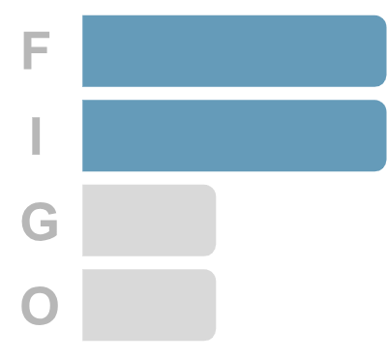
FIGO · CUSTOMER ANALYTICS
Predicting Customer Churn
Turning two years of till receipts into a weekly list of customers worth saving
Figo Data · August 2026

Slide 2
The Customer Who Never Says Goodbye
CONTEXT
SOLUTION
The Problem
The Approach
Grocery customers never cancel. They simply stop coming, and by the time the absence is obvious the relationship is already over. There is no cancellation event to react to and nothing in the weekly sales report that separates a quiet month from a customer who has gone for good.
A model reads each household’s recent shopping behaviour and estimates the chance they stop buying over the next four weeks. Because it looks forward rather than back, the team is told who is at risk while there is still time to act on it.
Who is affected: retention, marketing and store operations
How it works: behavioural scoring, ranked highest risk first
What it costs: revenue that leaves quietly and is rarely won back
What you get: a weekly list where 3 in 4 names are real leavers

Slide 3
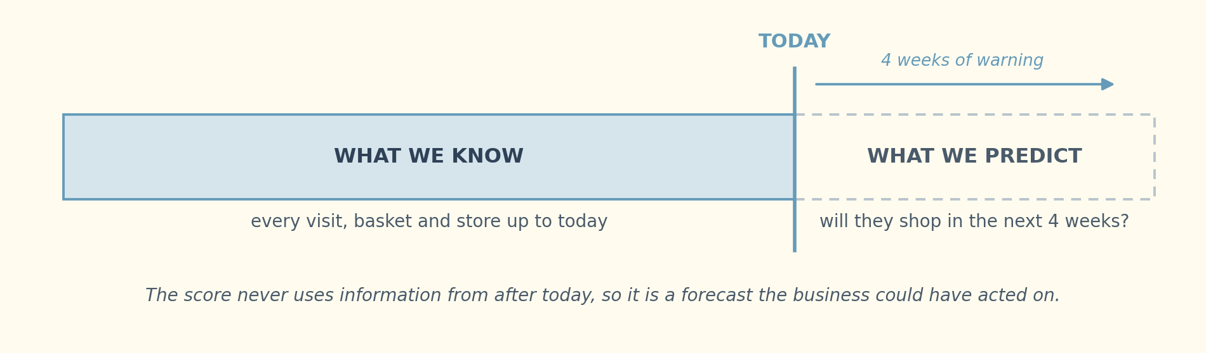

HOW IT STAYS HONEST
What the Model Is Allowed to See
The score is built only from what had already happened by the day it runs. Nothing from the four weeks being predicted is allowed in, which makes it a forecast.

Slide 4





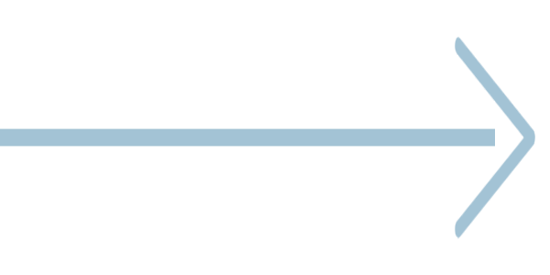
How a Customer Gets Scored
Every household passes through the same five stages each week, turning raw till data into a name a retention manager can act on. The score itself is never the deliverable; the ranked list at the end of the chain is.
Till Receipts
Profile
Risk Score
Ranked List
Action
two years of sales
frequency · spend · variety
chance of leaving
highest risk first
call · offer · voucher

Slide 5




What the Model Delivers
4.2x
3 in 4
50%
Better Than Guessing
Flagged and Correct
Of All Leavers Caught
Accuracy against picking households at random from the customer base
Of the fifty highest-risk households, thirty-seven genuinely stopped shopping
Half of everyone who left the business appears in a single list of fifty names

Slide 6
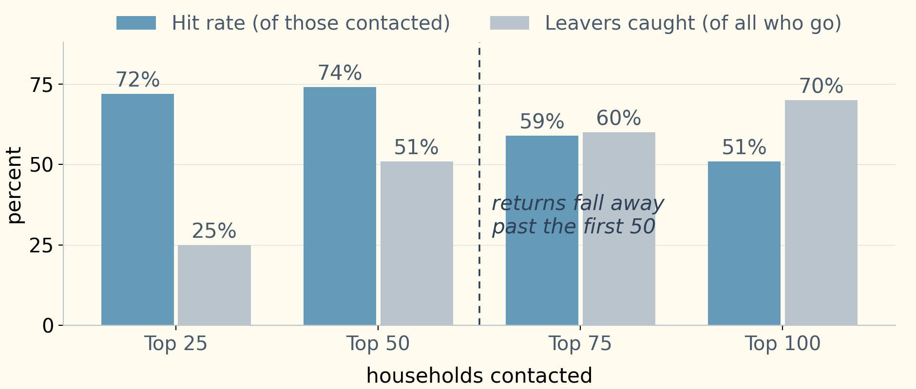
How Long Should the List Be?
TARGETING
KEY TAKEAWAY
Hit rate and coverage by list size
Fifty names is the point where accuracy and coverage are both still high.
Contacting more people always catches more leavers, but the hit rate drops once the list passes fifty. An expensive action should stop at fifty; a cheap automated offer can safely run further down. The right length is a budget decision, and the chart shows what each extra name costs in precision.

Slide 7



What Changes for the Retention Team
BEFORE
NOW
A regular customer is noticed as missing only once they are long gone
Households ranked by risk of leaving, four weeks ahead
Offers go to whoever is easiest to reach, or to the entire base at once
Retention budget aimed at the fifty names most likely to leave
No way to tell an ordinary quiet month from a lost relationship
A measured hit rate the team can track and improve every cycle
Warning time
None → 4 weeks
Hit rate
16% → 74%
Names to work
2,323 → 50

Slide 8



Recommendation at a Glance
Action
Benefits
Caution
Score the customer base weekly and hand the fifty highest-risk households to the retention team as a standing worklist.
Retention spend reaches customers who would otherwise leave unnoticed, with a hit rate that can be measured and improved every cycle rather than assumed.
The model ranks who to approach. It does not explain why they are leaving, and choosing the right offer still needs a human decision.

Slide 9


WRAP-UP
Timing is the whole product
Conclusion
A prediction that arrives after the customer has gone is a report. Four weeks of warning is what turns it into an intervention
The value of a churn model is not the accuracy score it reports. It is whether it produces a list short enough for a team to work through, early enough to act on, and reliable enough that they keep using it after the first month.
A short list beats a better score
Fifty names with three in four correct is worth more to a retention team than a marginally stronger model scoring the whole base
Test the obvious explanation first
Several promising signals turned out to be shopping frequency in disguise, and checking that before launch avoids acting on an effect that was never there
Next step
Score the base at several dates across the year to sharpen the model, and measure retention lift against a held-back control group

Slide 10




THANK YOU
Thanks!
If you enjoyed this content and want to explore more data topics, connect on LinkedIn or subscribe for future posts and discussions.
linkedin.com/in/andrey-de-sousa-figueiredo
andreydesousa92@gmail.com

